Slide 1
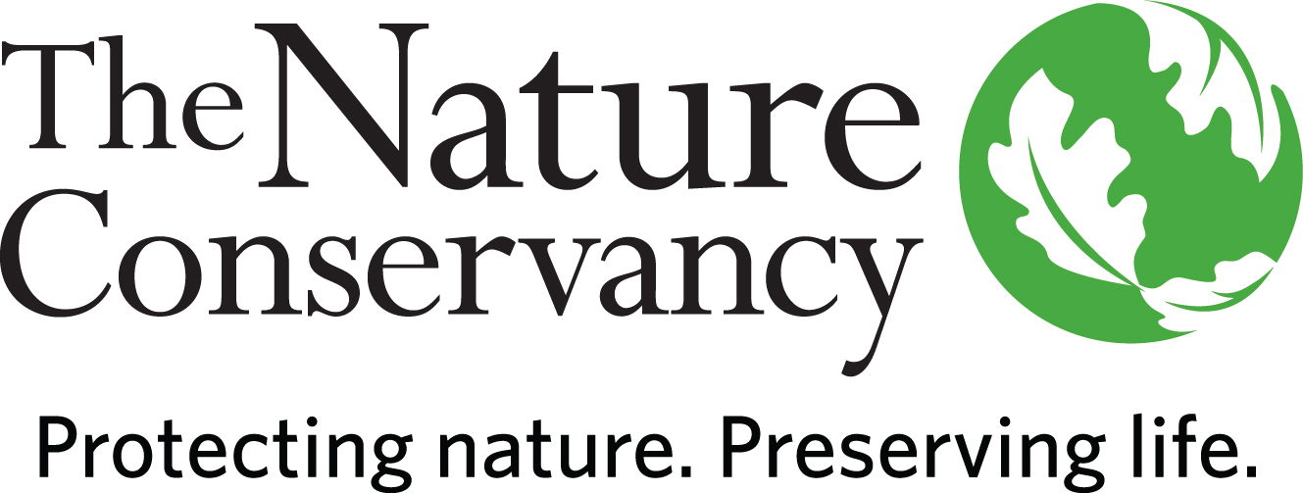
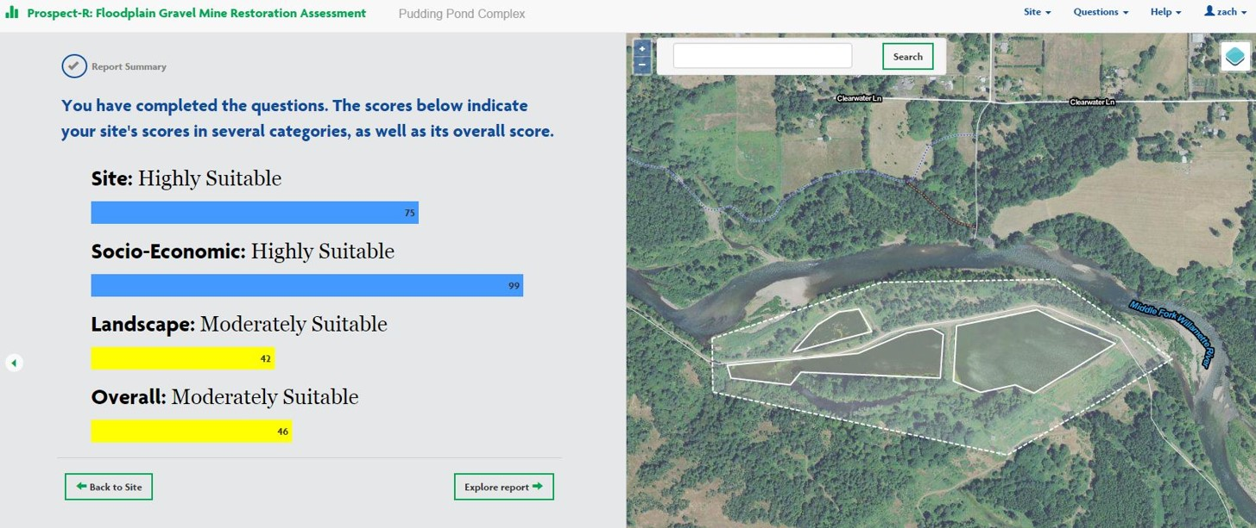
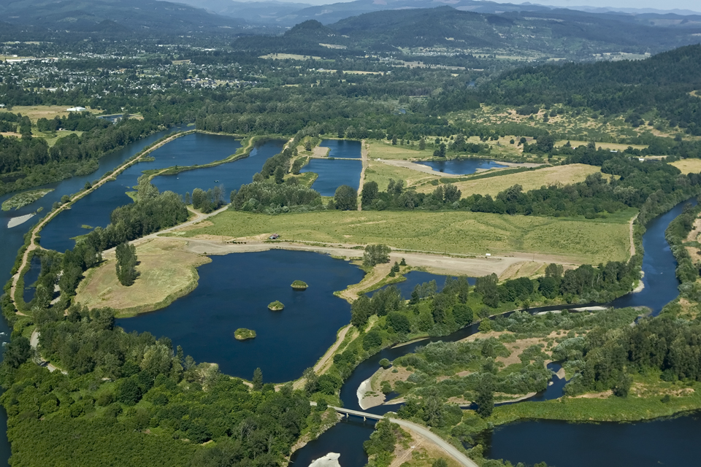
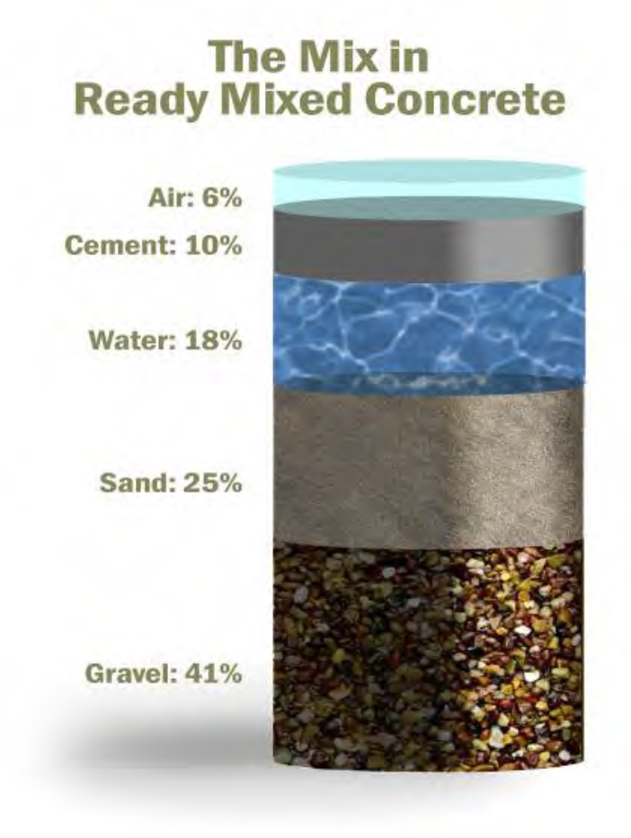
PROSPECT-R: a web-based decision support tool for aggregate mine restoration
Zach Freed, Jason Nuckols, and Melissa Olson
Prospect-R is an online decision support tool that helps users determine the feasibility of floodplain restoration efforts. Prospect-R was developed specifically for the restoration of aggregate pit mines on the Willamette River, but is ultimately intended to be used more broadly. Users of Prospect-R learn how to navigate the socioeconomic, ecological, and logistical components of restoration that should be evaluated before the project begins. The tool helps users organize their available data, broadly identifies the likelihood of project success, and pinpoints potential challenges that a project may encounter.
Try the tool yourself at http://prospectr.nature.org .
Beginning with acquisition in 2010, the Willamette Confluence has seen many changes in six short years. The restoration was phased into four unique projects, each with its own funding, design, engineering, permitting, construction, revegetation and monitoring challenges. Today three of these four projects are either completed (Pudding Pond) or in-progress (Coast Fork/Turtle Flats). We break ground on the final and largest project (Lower Middle Fork) in the summer of 2017. Revegetation and monitoring will continue through 2020. Completing these projects in succession has allowed us to learn from our experiences both for implementation purposes and for informing the conditional probability tables that make up Prospect-R.
What is Prospect-R?
Willamette Confluence
Preserve
In order to account for complex interactions between nested parameters, Prospect-R uses a Bayesian belief network written in the Bayesian interchange format (.bif). The model output in Prospect-R is an overall suitability score that is determined as a function of three general contexts: Landscape (reach-scale hydrologic and ecological conditions), Site (conditions specific to the proposed aggregate pit site), and Socioeconomic (legal and financial questions as well as public perception). Within each context, there are several categories comprised of multiple questions. The Bayesian
belief network allows
answers from some
questions to have
synergistic or
antagonistic impact
on answers from related
questions, and for scores
to propagate upwards
through the model.
Aggregate is mined as a construction material in floodplains throughout the world. There are more than 300 aggregate pit mine sites in the floodplain of the Willamette River alone. When they are abandoned, they leave behind deep ponds with steep banks and stagnant water. Many aggregate pit mines are ecologically, politically, and socially well-suited to restoration efforts. Among other things, restoration of aggregate pit mines can create new off-channel habitat like backwaters or side channels, restore channel mobility, and remove negative temperature and water quality impacts. However, there is a paucity of available data to communicate the “lessons-learned” from successful aggregate pit restoration projects.
How does it work?
Why aggregate mines?
Overall Suitability
Prospect-R is intended to be used by land managers, conservation groups, and agencies. The tool is user-friendly and does not require specialized experience in hydrology, ecology, or land management.
Who should use it?
Landscape Context
Geomorphic Controls
“The most widely used building material in Oregon isn’t timber, steel, plastic or glass. It’s aggregate, the sand, gravel, and crushed rock used to construct roads, foundations, buildings, and many other structures. Each year, a typical Oregonian uses about 17 tons of aggregate – one dump truck load of rock.”
Prospect-R was jointly developed by The Nature Conservancy and Ecotrust with the generous support of the Meyer Memorial Trust and the Wildlife Conservation Society. Special thanks to Dan Bell, Leslie Bach, Shonene Scott, Ryan Hodges, Mike Mertens, and beta testers who submitted feedback.
Material Availability
Oregon Department of Land Conservation and Development

